Slide 1
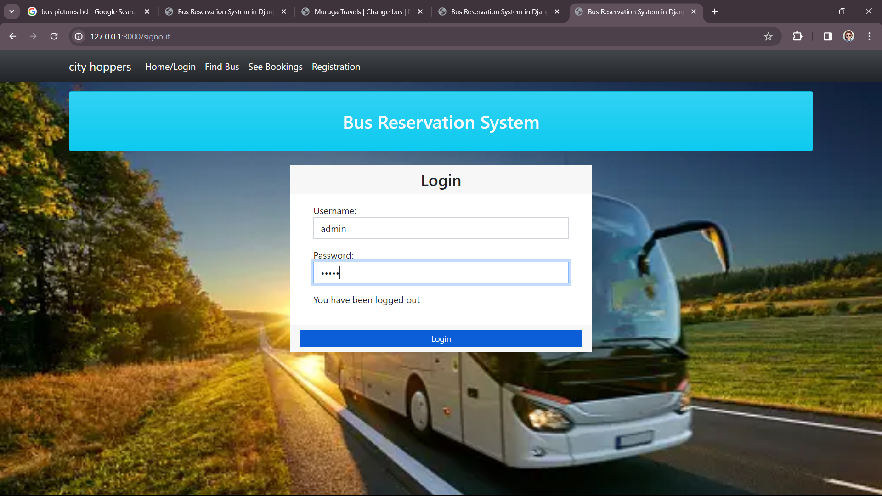
LOGIN PAGE

Slide 2
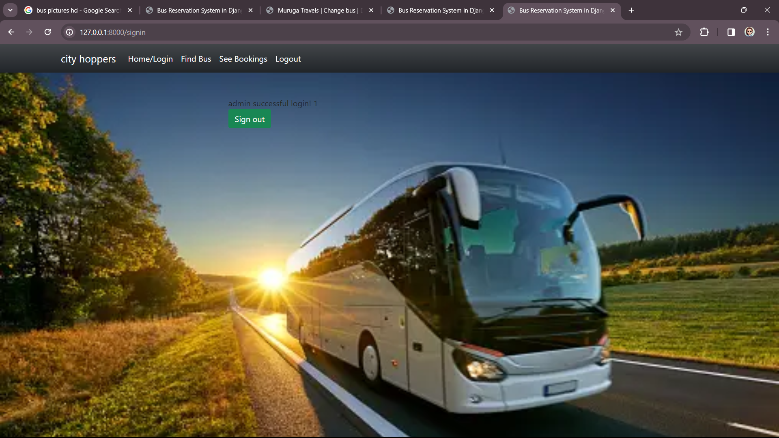
ADMIN PAGE

Slide 3
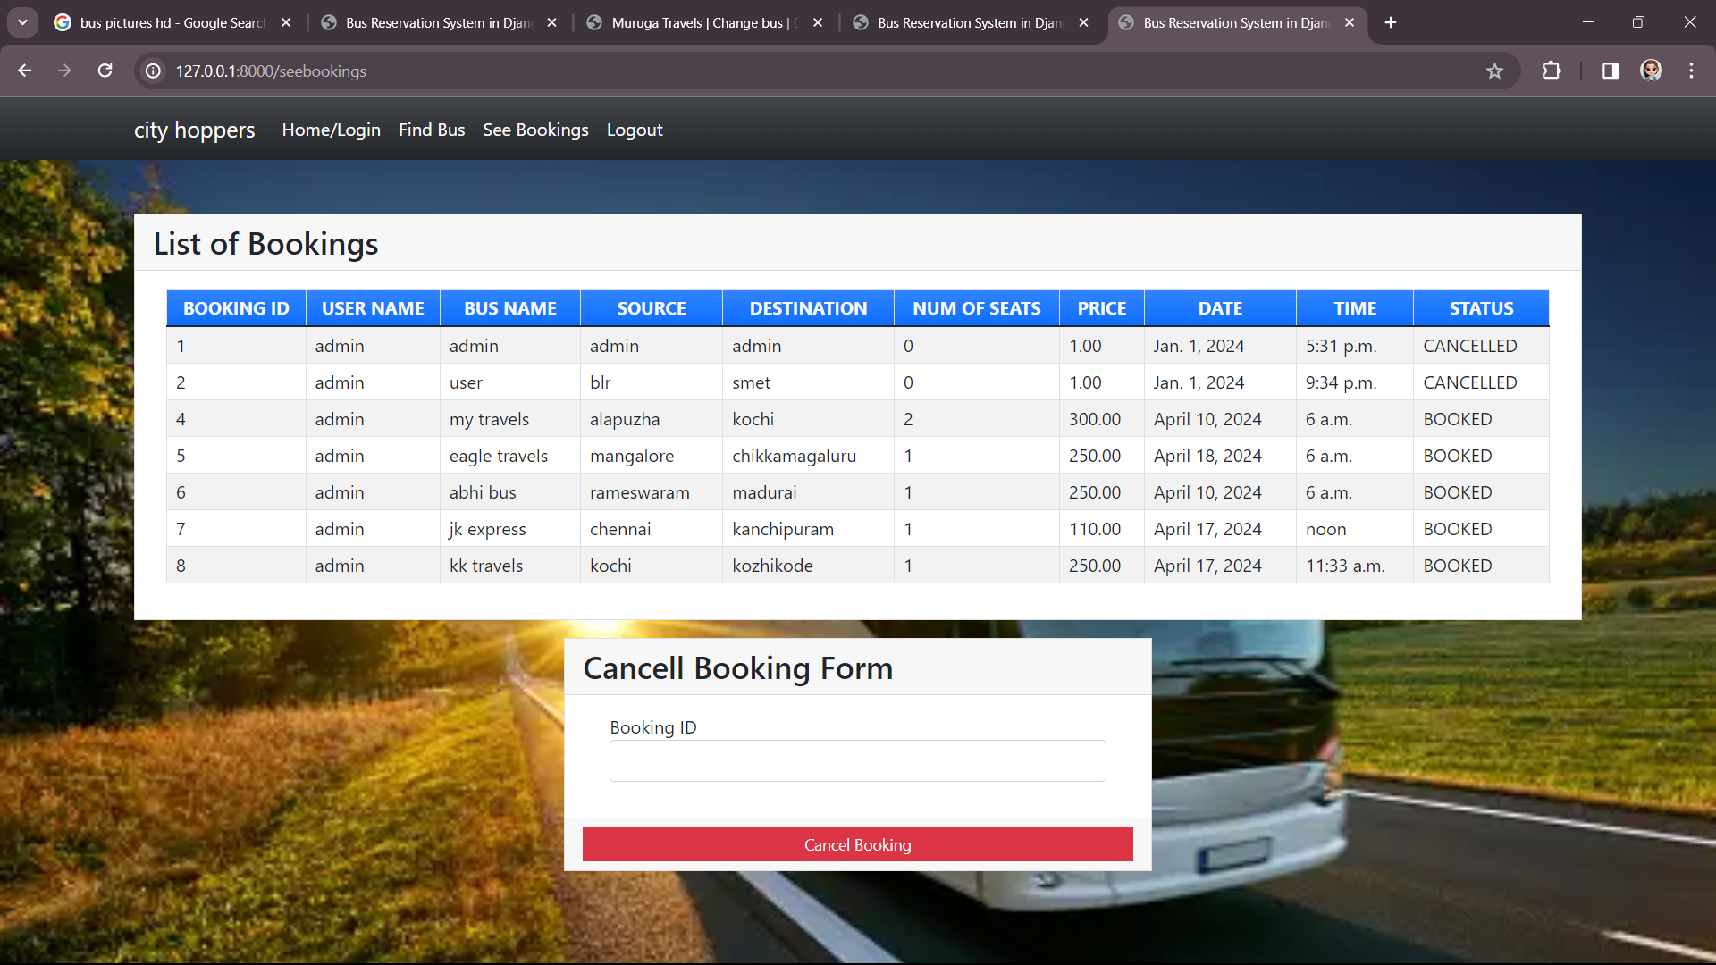
BOOKINGS

Slide 4
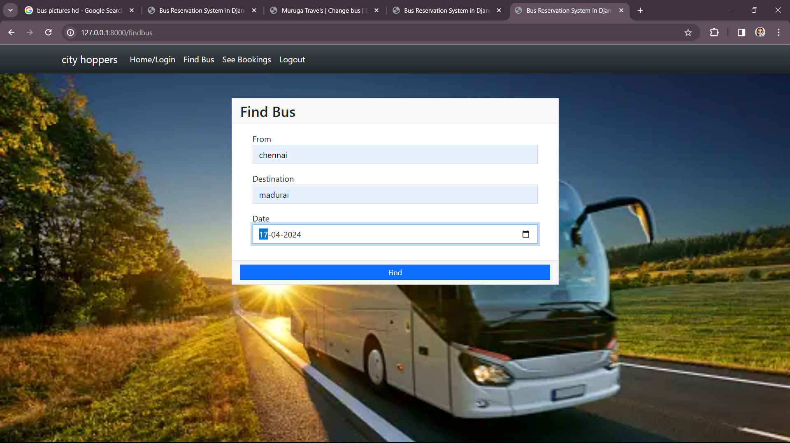
SERVICE PAGE

